Slide 1


Django Workshop 2022
Rishabh Rathi

Slide 2
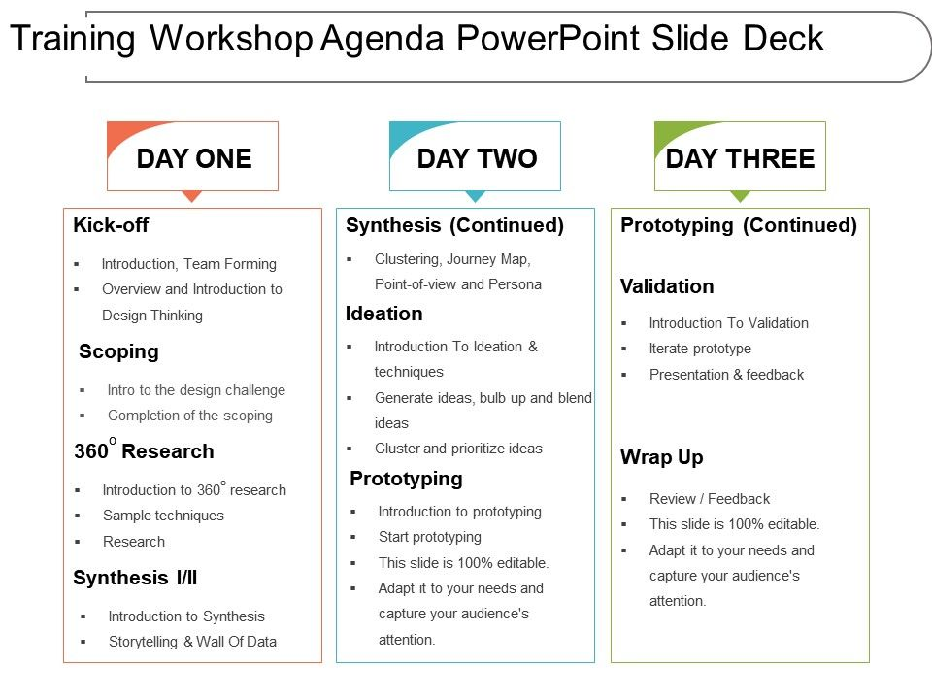
Agenda
Introduction to Backend
Complete Python Bootcamp course
Introduction to Django
Installing Django
Project Intro
Client - Server Model
Django's folder structure
Django Models
Django Templates
Creating home view
Creating Django Forms
Creating Django Models
Creating the url-shortener app
Creating analytics page
Creating Preview Page
Deploy on Internet

Slide 3
Today's Agenda
What is backend?
Introduction to Django
Installing Django
Django's Folder Structure
Creating Django Forms
Django Templates
Creating our Home page
Django Models

Slide 4
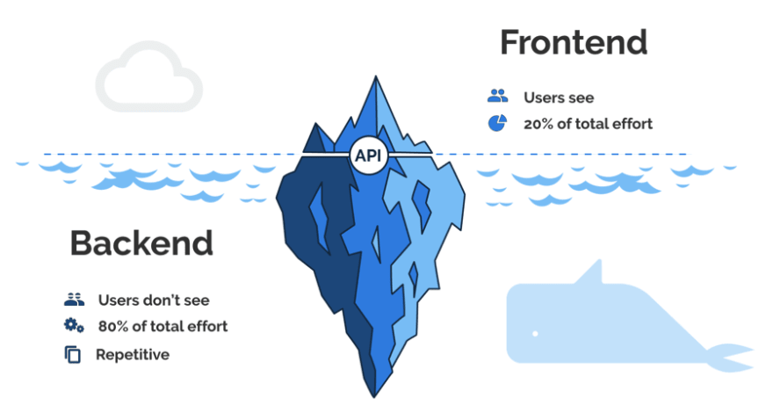
Frontend vs Backend
Languages
PHP
C++
Python
Java
Node.js
Languages
HTML
CSS
JavaScript
Frameworks
Express
Django
Rails
Laravel
Spring
Frameworks
AngularJS
React.js
jQuery
SASS

Slide 5
What is a Back-end?
When we talk about web development, we can usually think in terms of clients and servers.
Users interact directly with clients such as websites or mobile apps. These clients then send requests over the network to servers, which are programs that are running on some machine somewhere in the world.
Back-end Development refers to the server-side development. It is the term used for the behind-the-scenes activities that happen when performing any action on a website.

Slide 6
Best Back-end Frameworks
Framework | Programming Language | Famous Use Cases
Django | Python | Instagram, Pinterest, Coursera
Ruby on Rails | Ruby | ZendDesk, Shopify, GitHub
ExpressJS | NodeJS | MySpace, Storify
Flask | Python | Red Hat, Reddit
Asp .NET | C# | Microsoft, Godaddy, Ancestry
Spring Boot | Java | Trivago

Slide 7
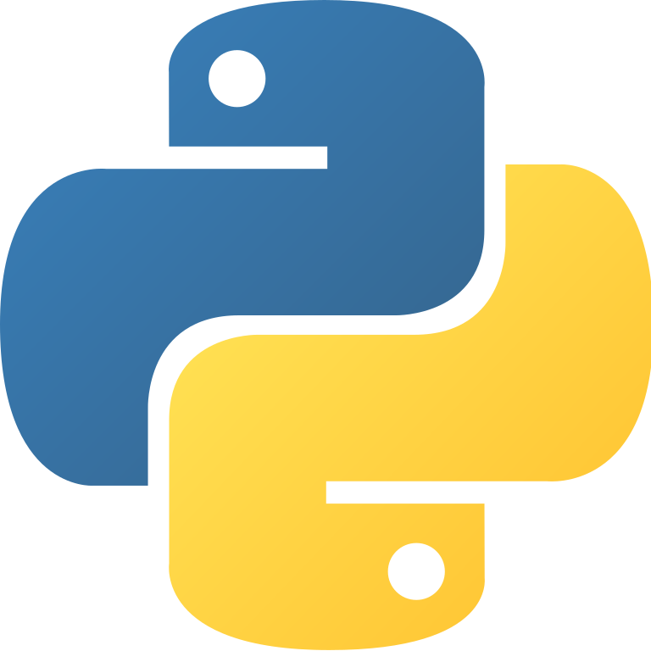
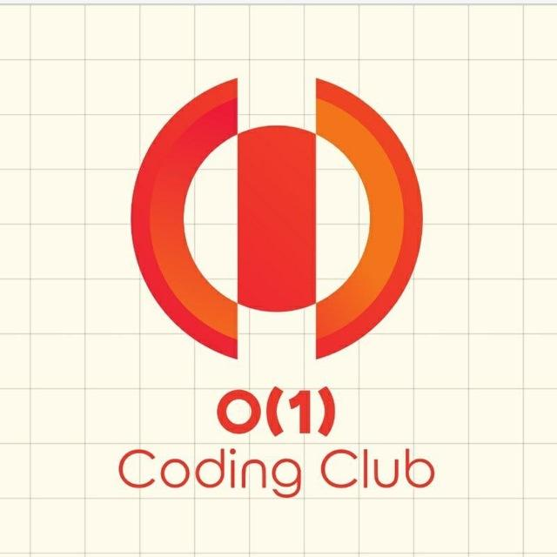

Introduction to
Speaker: Rishabh Rathi

Slide 8
What is Django?
“Django is a high-level Python web framework that encourages rapid development and clean, pragmatic design.”
The web framework for perfectionists with deadlines.
Free and Open Source.
Primary Focus
  Dynamic and database driven websites
  Content based websites

Slide 9
Why Django?
It’s fast and simple
DRY philosophy — Don’t Repeat Yourself — which means developers can reuse existing code and focus on the unique one.
As a result, it takes a lot less time to get the project to market.
It has one of the best out-of-the-box security systems out there.
With Django, you can tackle projects of any size and capacity, whether it’s a simple website or a high-load web application.
It’s fully loaded with extras and scalable, so you can make applications that handle heavy traffic and large volumes of information
Provides auto generated web admin

Slide 10
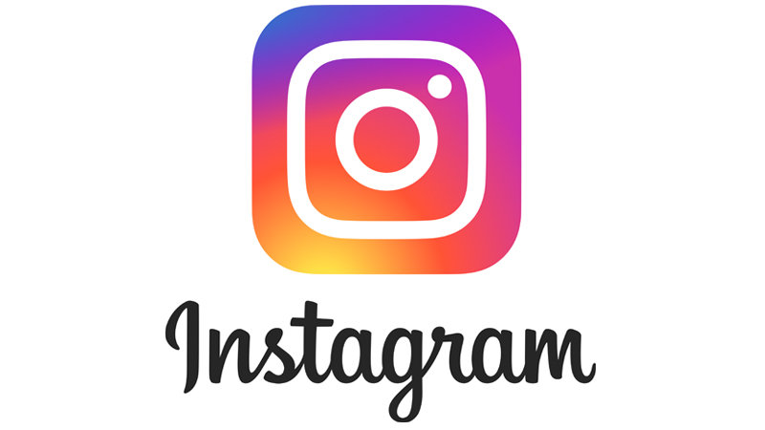
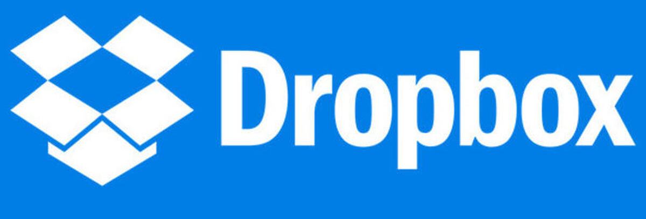
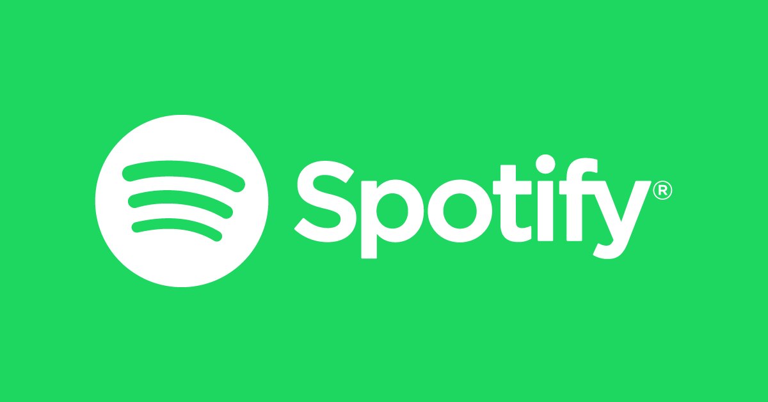
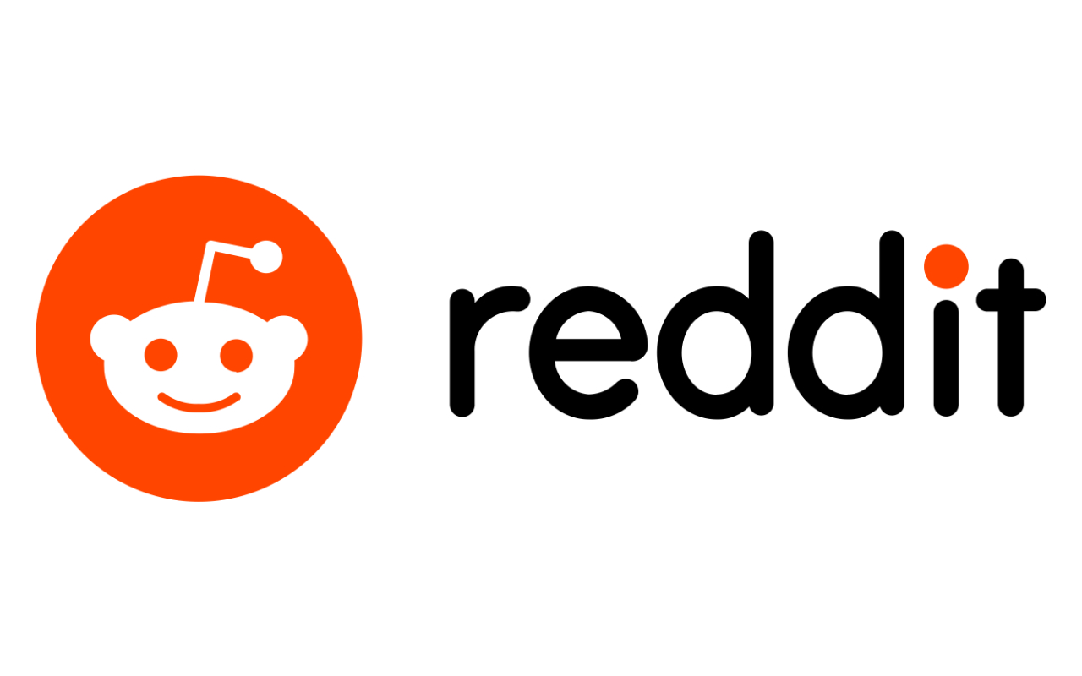
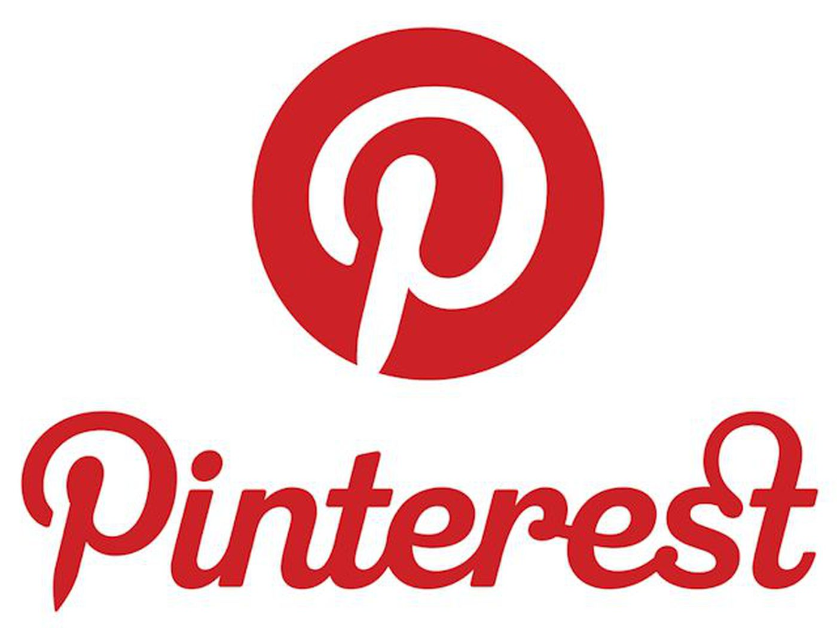
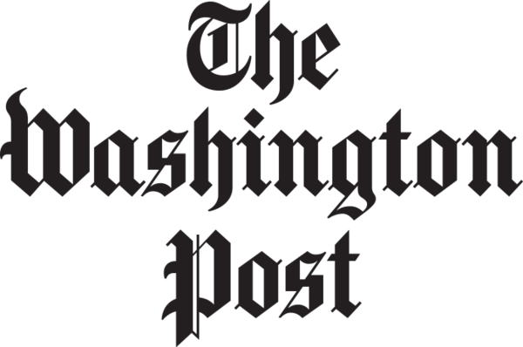
Famous Companies using Django

Slide 11
Virtual Environment
It works as a self-contained container or an isolated environment where all the Python-related packages and the required versions related to a specific project are installed.
In Summary, you can start an independent project related to Django of version 2.0, whereas another independent project related to Django of version 3.0 can be started on the same computer.

Slide 12
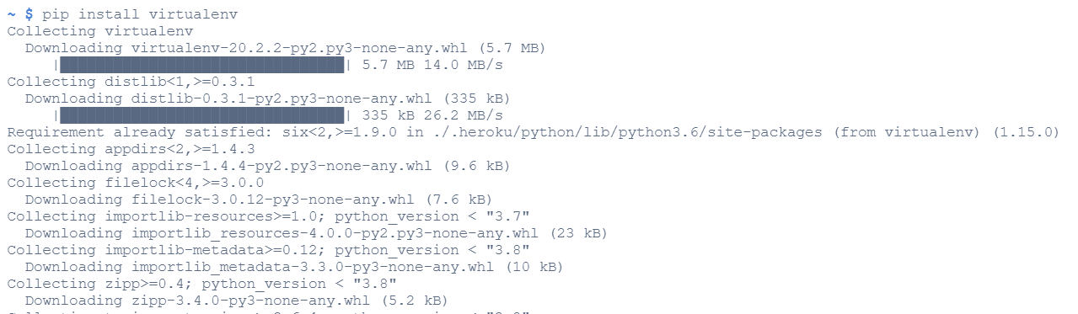
Install Virtual Environment
> pip install virtualenv

Slide 13
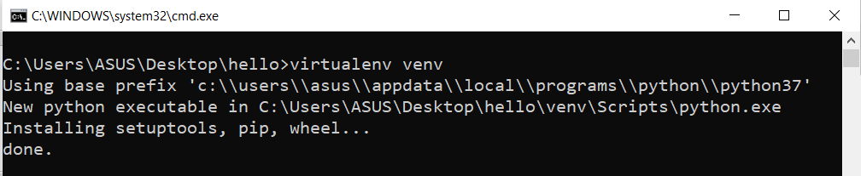
Create Virtual Environment
> virtualenv myvenv

Slide 14
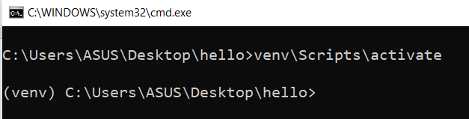
Activate Virtual Environment
> myvenv\Scripts\activate

Slide 15
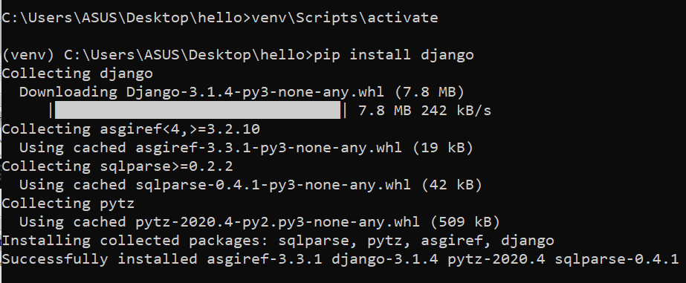
Installing the required package
> pip install django

Slide 16
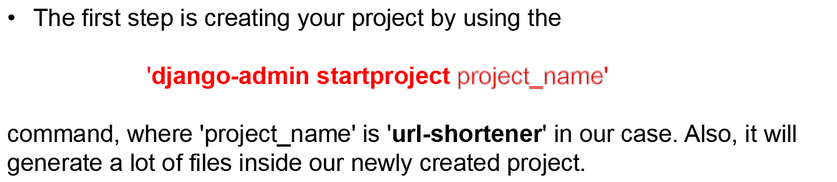
Creating a Django Project
Change the directory to the newly created project using 'cd' command
You can run your project by using 'python manage.py runserver'.

Slide 17
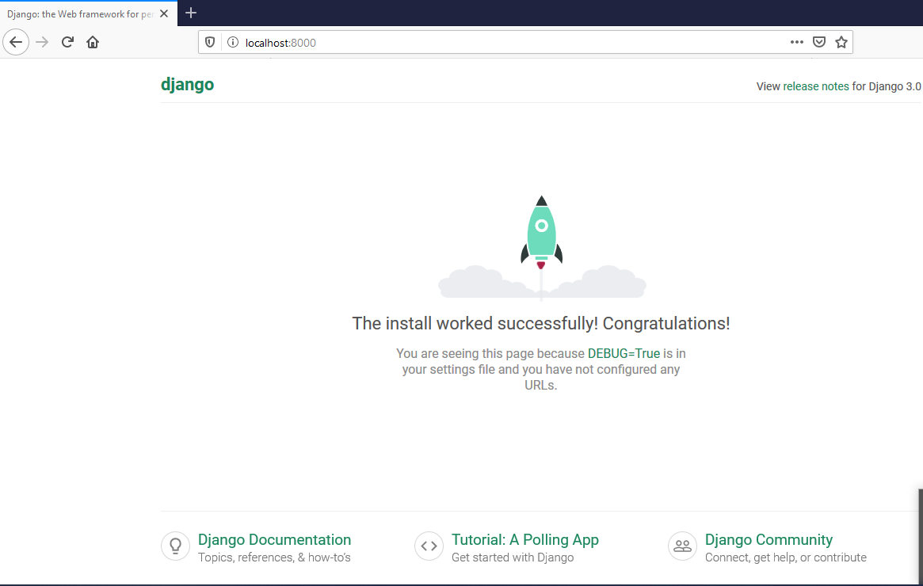
Creating a Django Project (contd.)
The project can be viewed in your favorite browser (Google Chrome, Mozilla Firefox, etc.). You can come into your browser and type 'localhost:8000' in the URL.

Slide 18

Create new app

Slide 19
Django MVT Architecture
Django is based on MVT (Model-View-Template) architecture. MVT is a software design pattern for developing a web application.
MVT Structure has the following three parts –
  Model: Model is going to act as the interface of your data. It is responsible for maintaining data. It is the logical data structure behind the entire application and is represented by a database (generally relational databases such as MySQL, Postgres).
  View: The View is the user interface — what you see in your browser when you render a website. It is represented by HTML/CSS/JavaScript and Jinja files.
  Template: A template consists of static parts of the desired HTML output as well as some special syntax describing how dynamic content will be inserted.

Slide 20
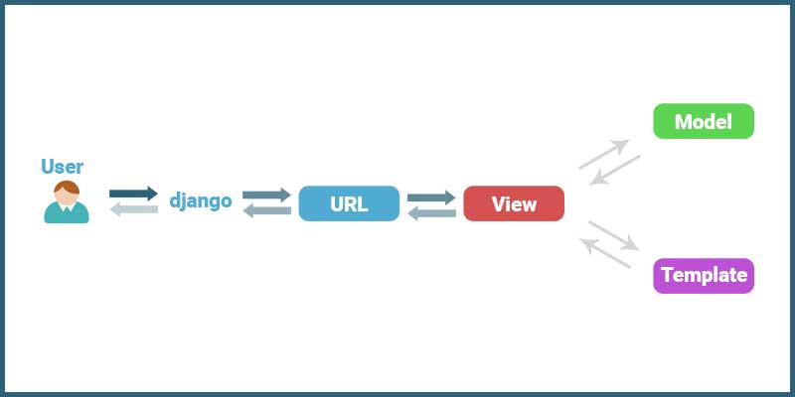
models.py
urls.py
views.py
Here, a user requests for a resource to the Django, Django works as a controller and check to the available resource in URL.
If URL maps, a view is called that interact with model and template, it renders a template.
Django responds back to the user and sends a template as a response.

Slide 21
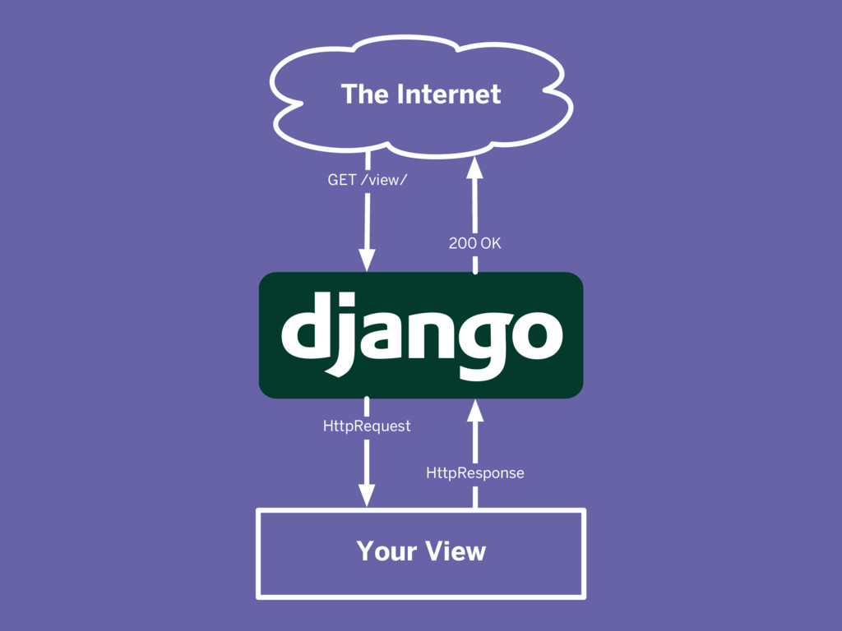

Slide 22
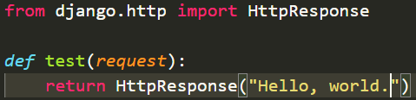
Write our first View

Slide 23
Django Template
Templates are the third and most important part of Django’s MVT Structure.
A template in Django is basically written in HTML, CSS and JavaScript in an .html file.
Django framework efficiently handles and generates dynamic HTML web pages that are visible to end-user.
Django mainly functions with a backend so, in order to provide frontend and provide a layout to our website, we use templates.

Slide 24
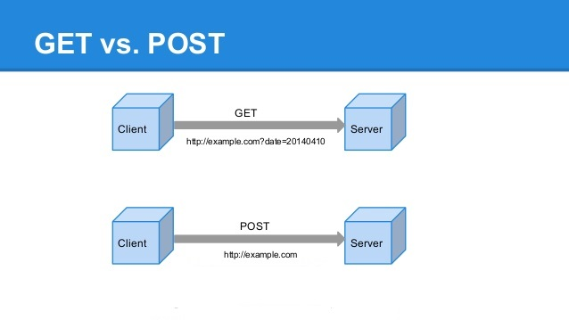
GET vs POST
The GET Method
GET is used to request data from a specified resource.
The POST Method
POST is used to send data to a server to create/update a resource.
Payload
Ex. Form data

Slide 25
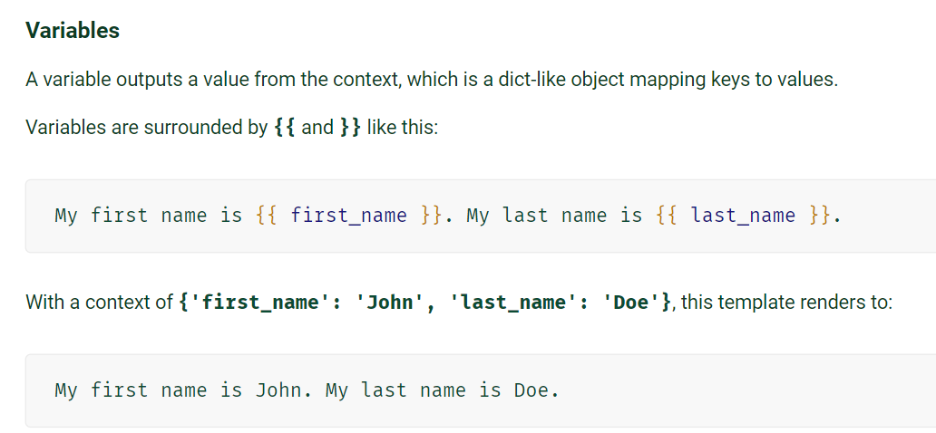
The Django template language

